Slide 1
Problem Solving as Search
CS161
Prof. Guy Van den Broeck

Slide 2


What is search?
Core AI problem
Long history, active topic
Basis for games, SAT, advanced reasoning
Used in many other fields
UCLA plays key role in history of search ☺

Slide 3
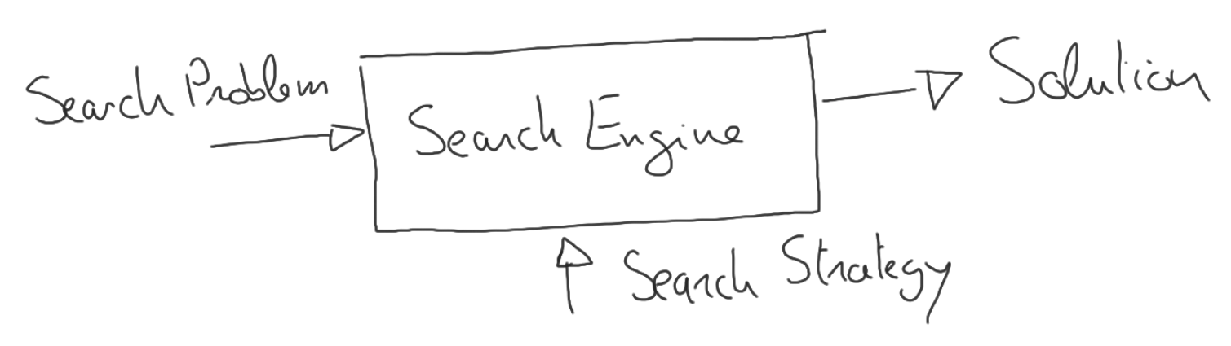
What is search?
Structure:
Sensitive to
problem formulation (today)
choice of strategy (next lectures)

Slide 4
Examples
Puzzles to illustrate basic concepts
8-puzzle
Missionaries and Cannibals
N-Queens
Crypto arithmetic
Rubik’s cube
Planning
Practical industry applications (e.g., Amazon delivery, Uber route and match, etc.)
How would you
solve these?

Slide 5
Search Problem Formulation
Common elements:
Initial state
Final/goal state or goal test/predicate
Actions
Transition model/successors
(Costs for actions)
Task: find sequence of actions to move from initial to goal state.
Optimal solution has lowest cost

Slide 6

Search Problem Formulation
Notions of state and action are not sharp!
Design problem: art
Example: 8-puzzle?

Slide 7
Observations
States are atomic (no internal structure)
States are discrete
No percepts
Deterministic transitions
Choice of action space is important
Move tile x up, down, left, right?
Move blank up, down, left, right?
More elegant, fewer actions!
Actions may not be applicable to all states

Slide 8
Search Trees
Example: 8-puzzle?

Slide 9
Observations
Some paths include the goal state
Solving the search problem is finding such path
Some paths are infinite (tree infinite)
Beware: Repeated states
Search space vs. search tree
Different solutions with different qualities

Slide 10
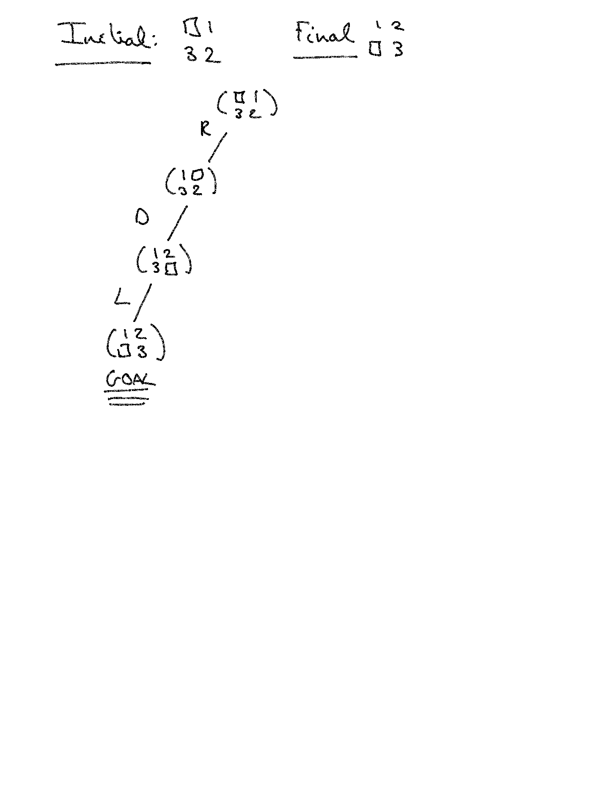
Search Trees: Finding Solutions

Slide 11
Search Trees: Finding Solutions

Slide 12
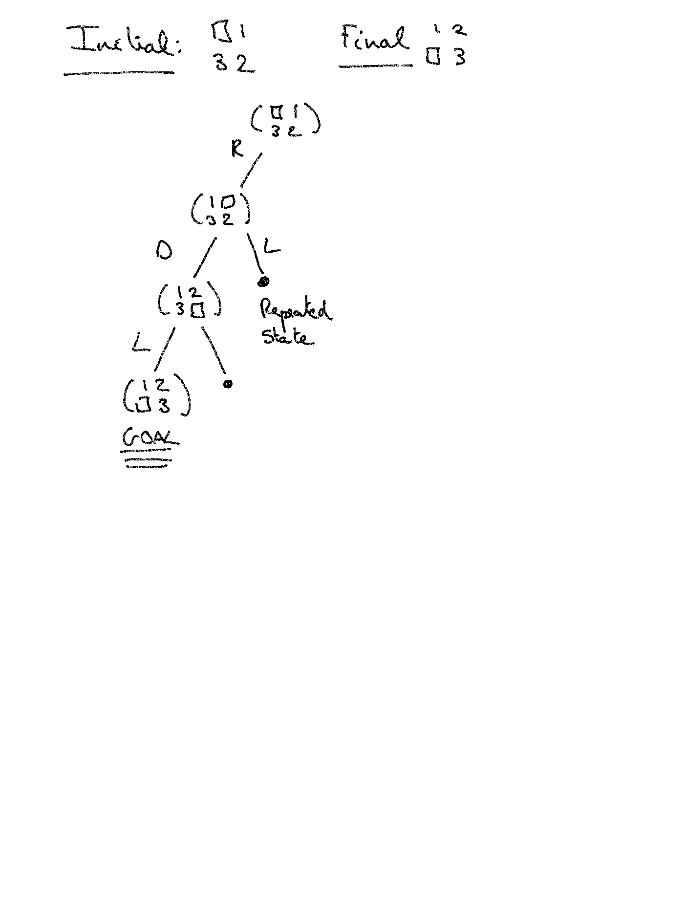
Search Trees: Finding Solutions

Slide 13
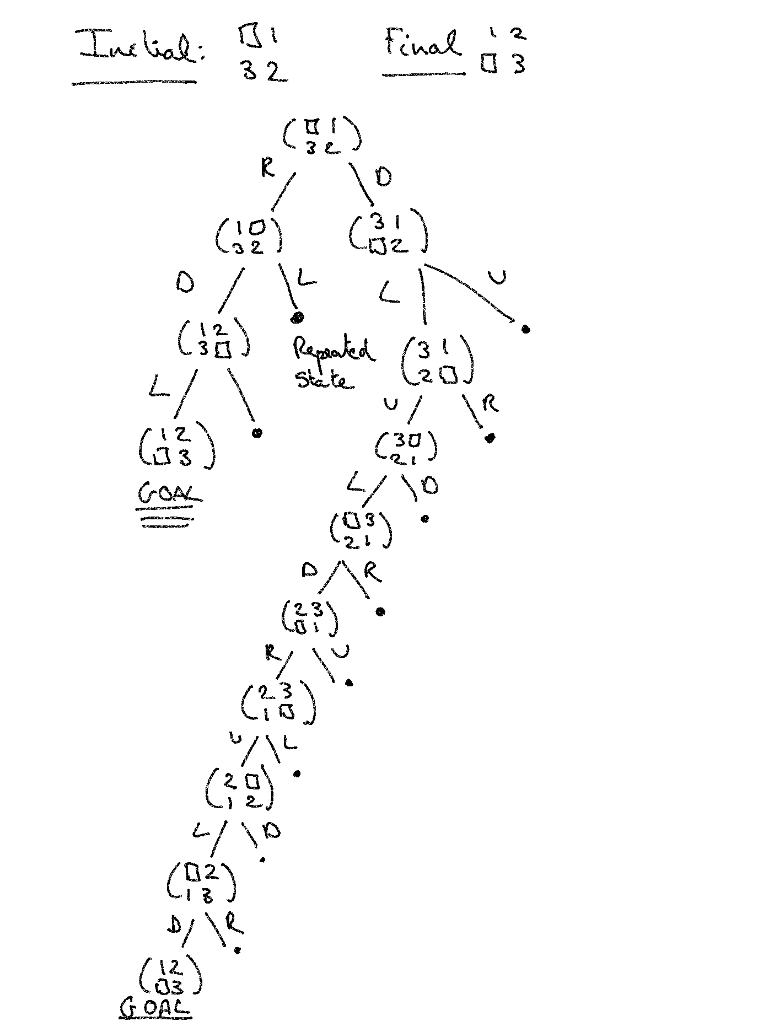
Search Trees: Finding Solutions

Slide 14
Observations
Avoid repeated states or run into infinite loop
Two solutions: cost 3 and cost 9
Difficulty of problem: measured by parameters
Number of states
Branching factor
Solution depth
How many unique states? 9! = 362,880
16! = 20,922,789,888,000
15-puzzle has trillions of states: few ms to solve
24-puzzle has 10^25 states: one day to solve (old version of book wrong)
Solving sliding block puzzles is NP-complete!

Slide 15
Search Trees: Finding Solutions
Example: Missionaries and Cannibals?

Slide 16
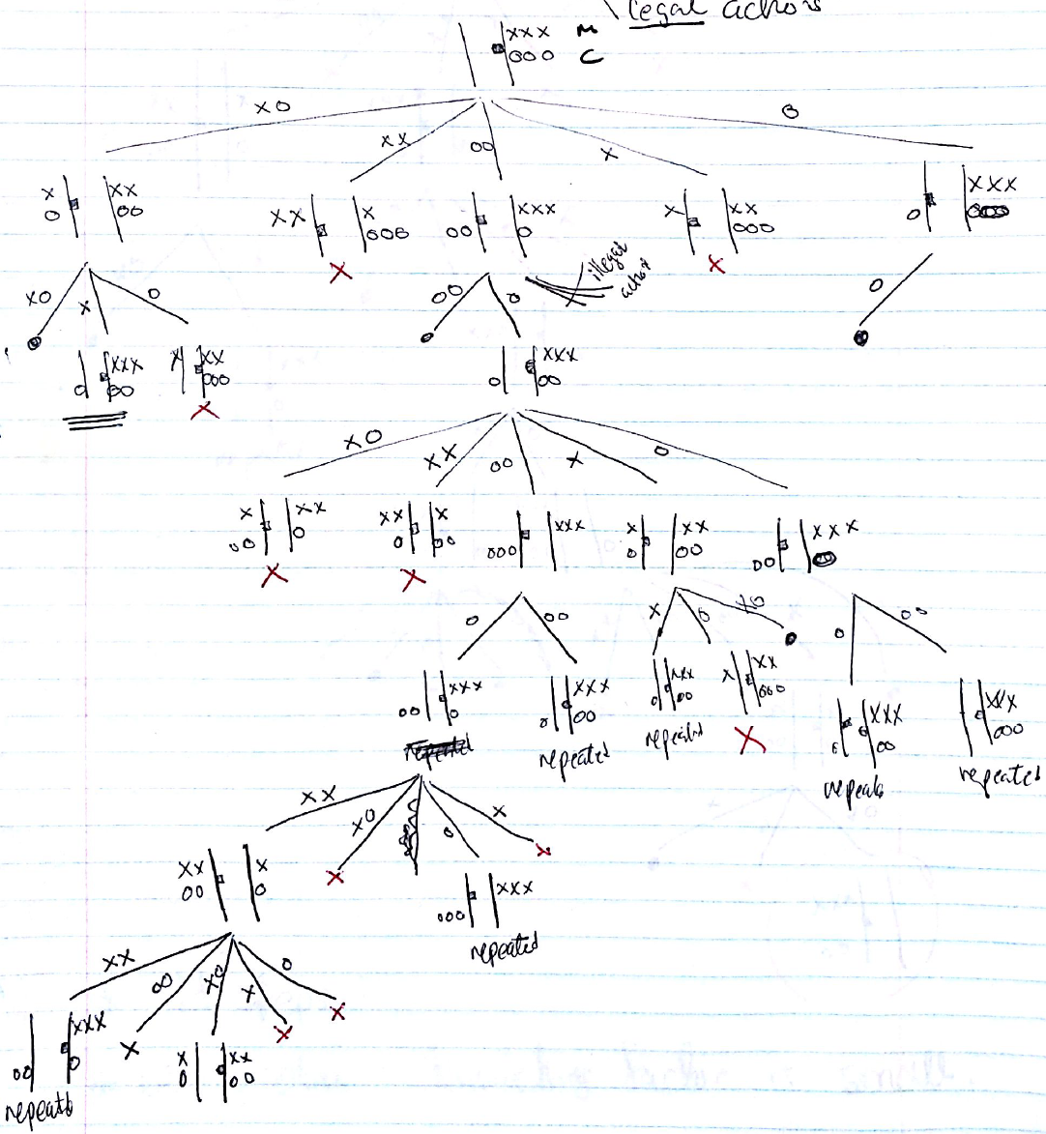

Slide 17
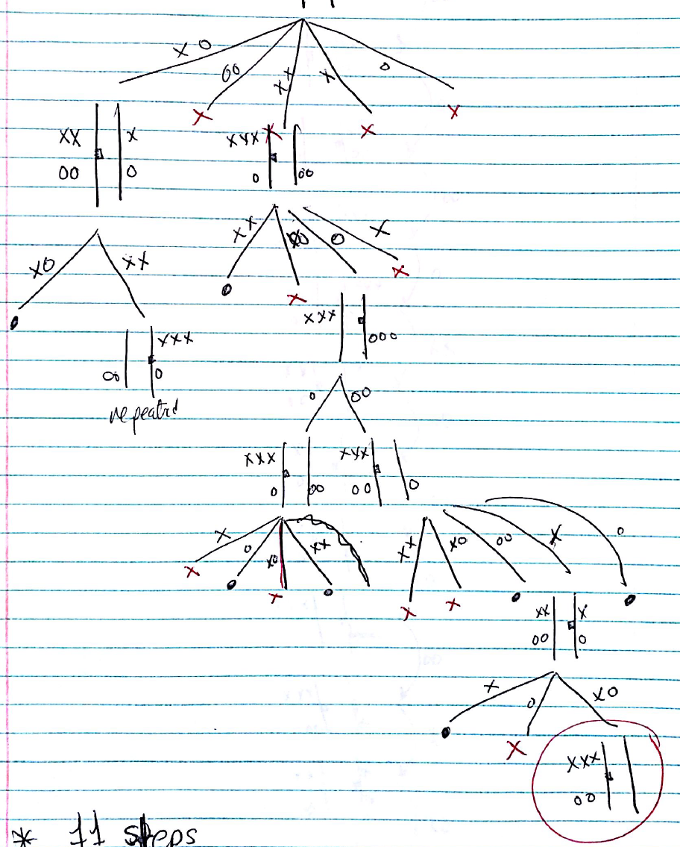

Slide 19
Observations
Many choices for
State description
Actions
Many correct, some better than others
Find correct level of abstraction

Slide 20
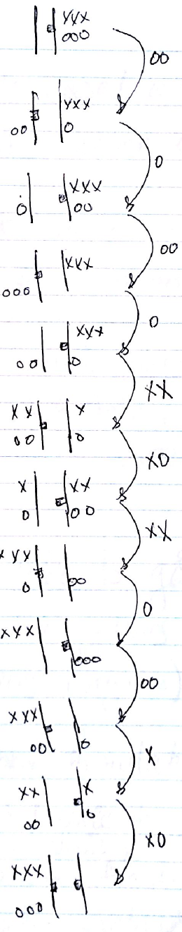
Solution

Slide 21
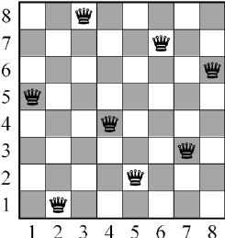
Search Trees: Finding Solutions
Example: 8-Queens?

Slide 22
Observations
State formulation:
Incremental state
Complete state
May or may not allow bad intermediate states
No goal state => goal predicate
Solution cost:
Incremental state: 8
Complete state: 0-8 (Can be solved in 0 moves!)

Slide 23
Search Trees: Finding Solutions
Example: Crypt-arithmetic?
FORTY
TEN
TEN
+-------
SIXTY
29786
850
850
+-------
31486

Slide 24
Observations
Incremental or complete state
Assign numbers to letters in fixed order
(better: smallest number of remaining values)
… see Constrain Satisfaction later

Slide 25
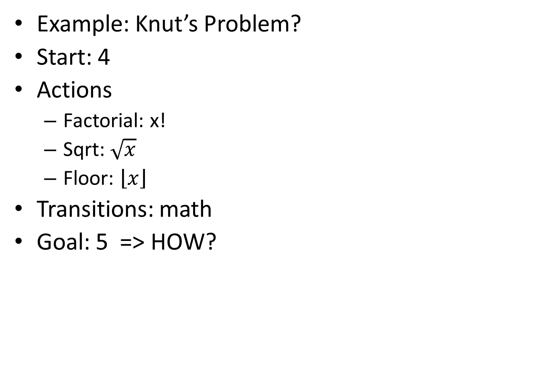
Search Trees: Finding Solutions

Slide 26
Observations
Conjecture: Any positive integer can be reached
No bound on intermediate representation
Infinite state space
Example of class of problems: recursively defined objects
Circuits, proofs, programs, etc.

Slide 27
More Real-World Search Problems
Route finding
Amazon one-day delivery, computer networks, travel planning, airline planning, navigation systems
Traveling salesperson problems
Planning circuit board drill movements, mail delivery, street cleaning, etc. What is a state?
Hardware layout
Continuous robot navigation
Scheduling
Theorem proving, Symbolic integration, etc.

Slide 28
Extensions/Complications
Minimizing solution cost (‘optimal solution’)
Cost of solution is sum of action costs
Note sure about effect of actions
Non-determinism (see probability later)
Note sure about initial state
Contingent planning: action based on sensing
Conformant planning: plan without sensors
Example: Not knowing initial state (see next)

Slide 29

Vacuum Cleaner World

Slide 30
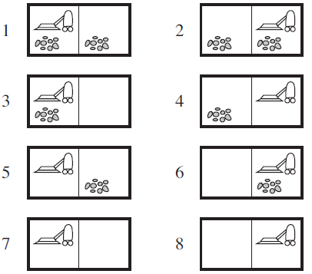

Slide 31
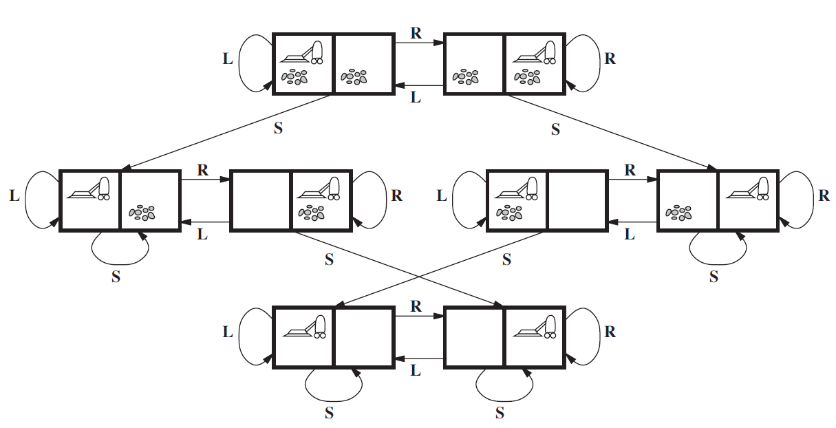

Slide 32
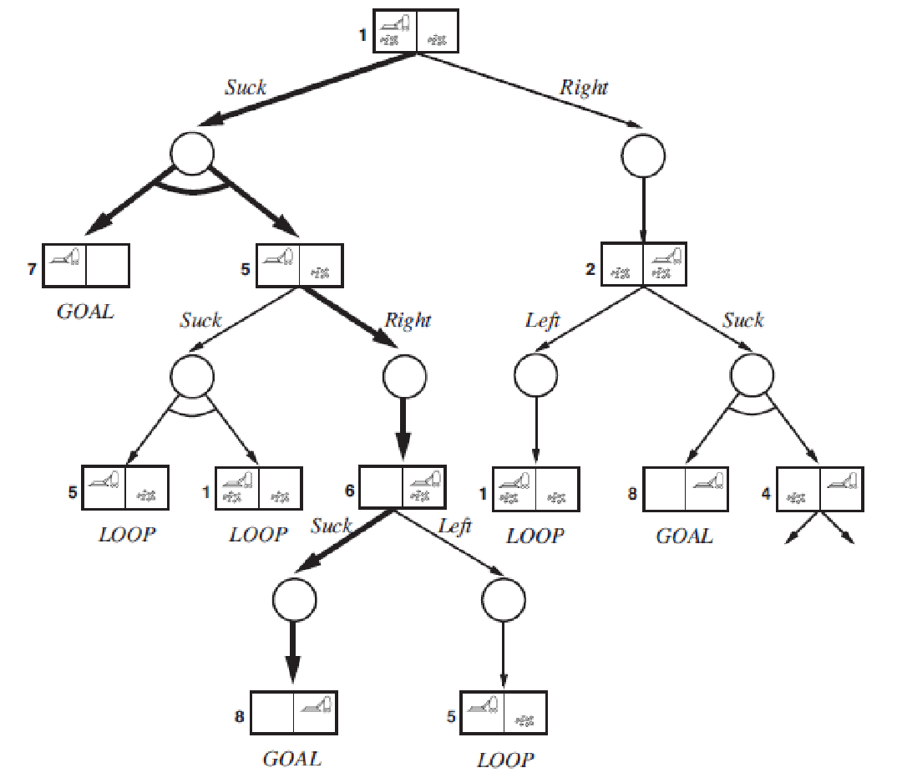

Slide 33
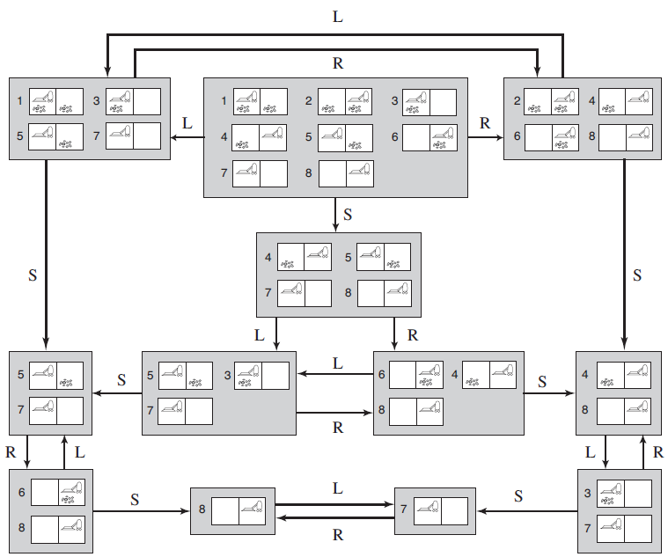

Slide 34
Observations
When uncertain about initial state, use belief states.
Belief state is a set of deterministic states
See later: assign probability to states

